Slide 1
Enhancing LLM-Generated Fuzz Driver Performance Through Iterative Prompts
Team 1: Andrew Bush & Mitchell Windahl
12/3/2025
Notes:
Mitchell -
Hello,
We are team 1, My name is Mitchell, this is Andrew, and today we will be introducing our project proposal on Enhancing LLM Fuzz Driver Coverage Through Iterative Prompts

Slide 2
Problem
Modern code uses an extensive number of libraries
Fuzzing remains one of the most reliable methods of securing libraries
Writing good fuzz drivers is hard and requires deep knowledge
How do we ensure code libraries are safe from vulnerabilities?
Notes:
Mitchell - The core problem that we are attempting to address is ensuring that code libraries remain free from potentially damaging vulnerabilities. Modern coding relies heavily on pre established libraries which could unknowingly be introducing many software bugs into the projects that incorporate them.
In order to detect and patch these bugs, the use of fuzz programs has been essential for testing libraries thoroughly to ensure malformed inputs will not produce unexpected outputs.
Typically, in order to properly fuzz a library, a “fuzz - driver” would be coded to ensure every function in the library is tested, but crafting these drivers requires an in-depth knowledge of the code, which represents a significant challenge to anyone thinking of auditing a library’s security.

Slide 3
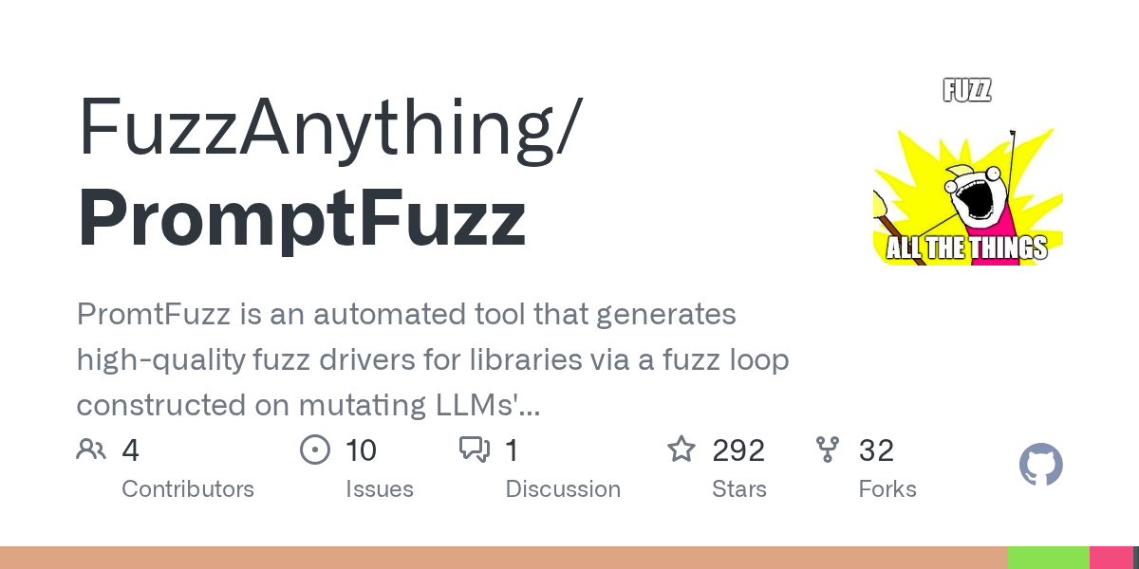
Baseline - PromptFuzz
Tool introduced in Prompt Fuzzing for Fuzz Driver Generation (Lyu et al., 2024)
Program that generates the fuzz drivers for a given program using a LLM.
Verifies the driver correctness by doing syntactic and semantic checking.
Notes:
Mitchell -
That leads us to our baseline; introducing PromtFuzz
Originally debuting in late 2024, PromtFuzz is a program that utilizes LLMs to generate high-quality fuzz drivers for a given library. Many checks are performed on the generated drivers to ensure correctness and fullness of scope.

Slide 4
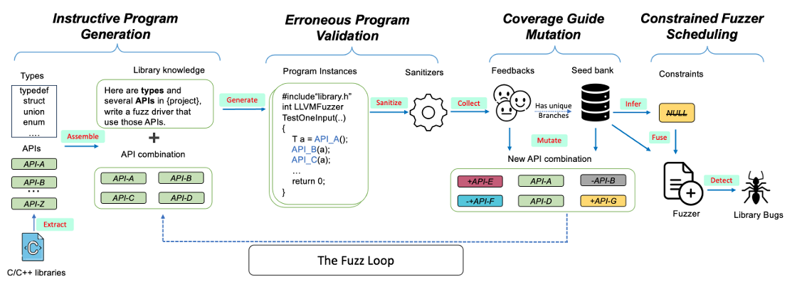
Fuzz Driver Generation in PromptFuzz
Notes:
Mitchell -
This is the overview and flow diagram of how PromptFuzz operates. It is split between 4 phases of operation which each play an important role in developing a specialized fuzz driver.
The first phase, the instructive program generation section, is where Promtfuzz takes API and function calls from the target library, formats them, an places them into a prompt which gets send to the target LLM to generate a fuzz driver.
In the second phase, the driver code is received and run through a sanitization module (utilizing clang and LLVM) to ensure that the program runs, notably, problematic or erroneous code is discarded completely at this phase of generation.
The third phase takes valid fuzzers and assess them for their completeness and coverage of functions an APIs. This grey-box style segment tracks how often the returned programs cover specific code branches and function calls to determine which branches are underexplored or unrepresented. These programs get stored in a “seed bank” which weights programs on the previously mentioned criteria. It then mutates the prompt from phase 1 to try to incorporate the lesser used function and establishes a “Fuzz loop” of sorts where programs are recursively fed from the LLM back to the seed bank until all paths are explored or the LLM query token limit is reached. Lastly, the program analyzes the seed programs’ data flow to guess API argument constraints, and replaces those elements (such as hard coded constants) with fuzzable variables.
It then merges validated “unique” seeds (programs that covering distinct branches) and builds a unified fuzz driver with randomly generated inputs.

Slide 5
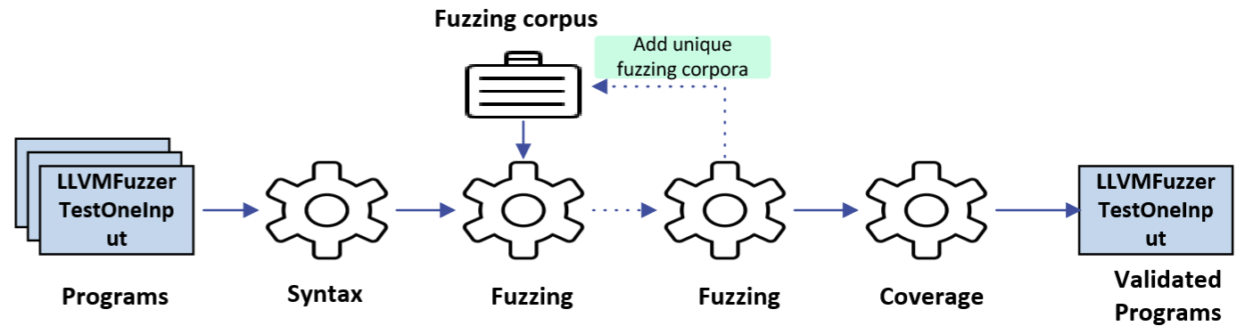
Erroneous Program Validation
Syntactically Incorrect Code Removed Here
Notes:
Andrew -

Slide 6
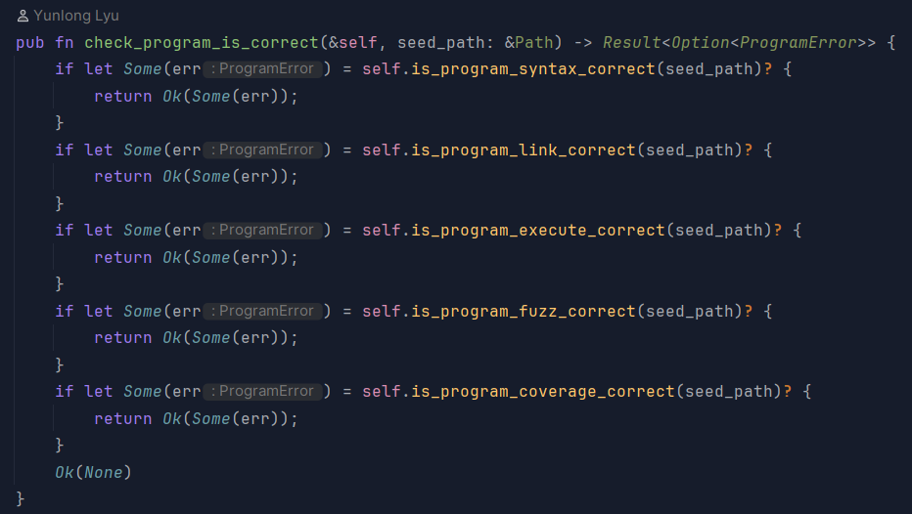
Syntax Module Code

Slide 7
Our Contribution - Iterative Prompting before Sanitization
LLM generated code is susceptible to having syntax errors, 63.9% of programs contained these errors in testing.
PromptFuzz currently discards programs with syntax errors from the generated driver, which is inefficient and may result in reduced code coverage.
We will attempt to fix this by iteratively prompt a LLM specifically on the extracted erroneous code.
Notes:
Andrew -

Slide 8
Inspiration
When Fuzzing Meets LLMs: Challenges and Opportunities
Jiang et al, 2024
Analyzed trends in LLM assisted fuzzing research.
Recommended iterative repair loops as a means to remediate syntax errors
Conducted after Promptfuzz
Is this insight useful for prompt fuzz?

Slide 9
Relevant Works:
Fuzzomatic
Introducing Fuzzomatic: Using AI to Automatically Fuzz Rust Projects from Scratch - Kudelski Security Research Center
Nils Amiet, 2023
Rust fuzzer developed in python
Utilizes LLMs in a similar fashion to PromptFuzz
Fixing Compilation Errors:
Feeds the LLM the errors and asks it to fix the code without modifying its behavior
Fuzz target generation using llms
https://google.github.io/oss-fuzz/research/llms/target_generation/.
Dongge Liu, J. M., and Chang, O. 2023
Research using OSS-Fuzz, an open source fuzzing framework
Utilized LLMs to write fuzz targets
Fixing Trivial Errors:
Iteratively feeds erroneous code to an LLM for fixing whilst also checking to ensure the libraries being tested are included.
Notes:
Andrew -

Slide 10
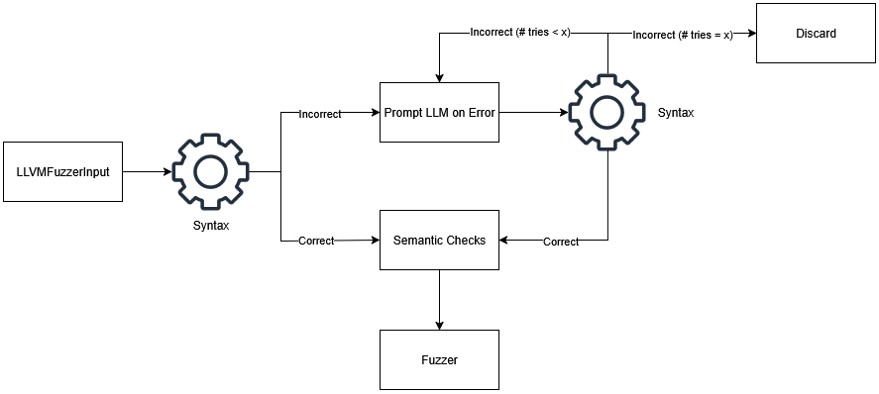
Iterative Prompting
Notes:
Andrew -

Slide 11
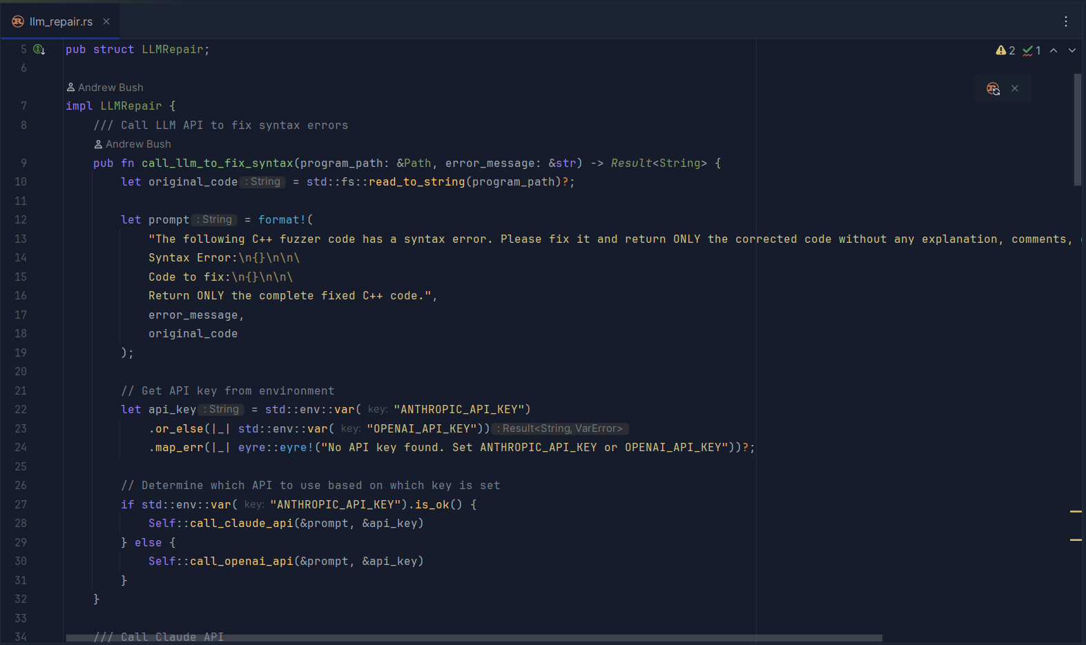
Repair Prompt
Notes:
For Final presentation: go up to here

Slide 12
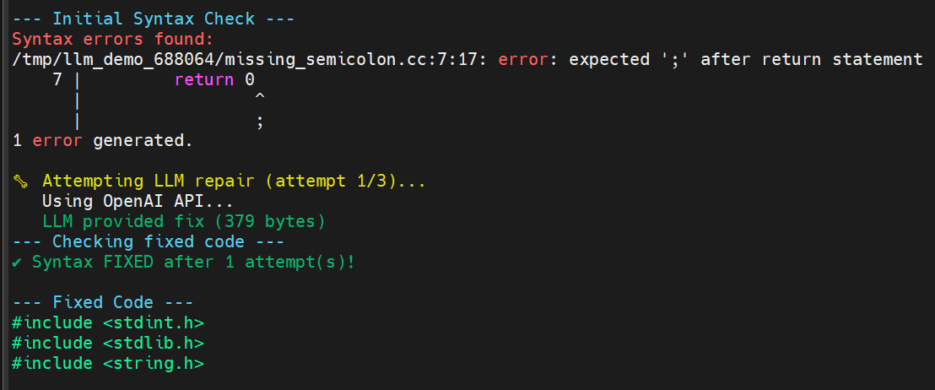
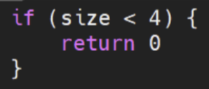

Fixing Code Sample Output

Slide 13
Initial Methodology
1:
Implement a functioning iterative syntax repair loop
2:
Run with/without iterative prompting to generate metrics
3:
Compare results to published paper to determine practicality

Slide 14
Experiment Setup
AI Model = GPT 4.1 Nano
Context Limit = 8192
All run on remote Ubuntu server
(24 cores, 256 GB RAM, NVIDIA Quadro RTX 5000)
Focusing on speed, and inducing syntax errors for testing

Slide 15
Main Branch Issues
Testing revealed published PromptFuzz main branch contains broken error detection.
Even when generated programs were complete jargon (temperature=2), errors went undetected until they were passed along and reported as fuzzer errors.
The JSON error parsing logic had to be reworked, looks for last set of { } brackets. Pull request material.

Slide 16
Main Branch Improvements
Revised the JSON format for error codes, restoring original functionality as it appeared in the paper.
Clarified code elements (function names and comments).
Added additional error checking and logging if program is run from the wrong directory. (specifically for libpcap, FDSan.h will be missing)

Slide 17
Revised Methodology
1:
Implement a functioning iterative syntax repair loop
2:
Develop test suite for syntax repair for identifying LLM repair capabilities
3:
Run test cases against module to test effectiveness in specific scenarios

Slide 18
Findings
LLM repair worked on all test cases (8/8 passed, only 1 iteration)
Valid Program (no repair)
Missing Braces
Missing Semicolon
Keyword Typo
Missing Type
Unmatched Parenthesis
Multiple of the above

Slide 19
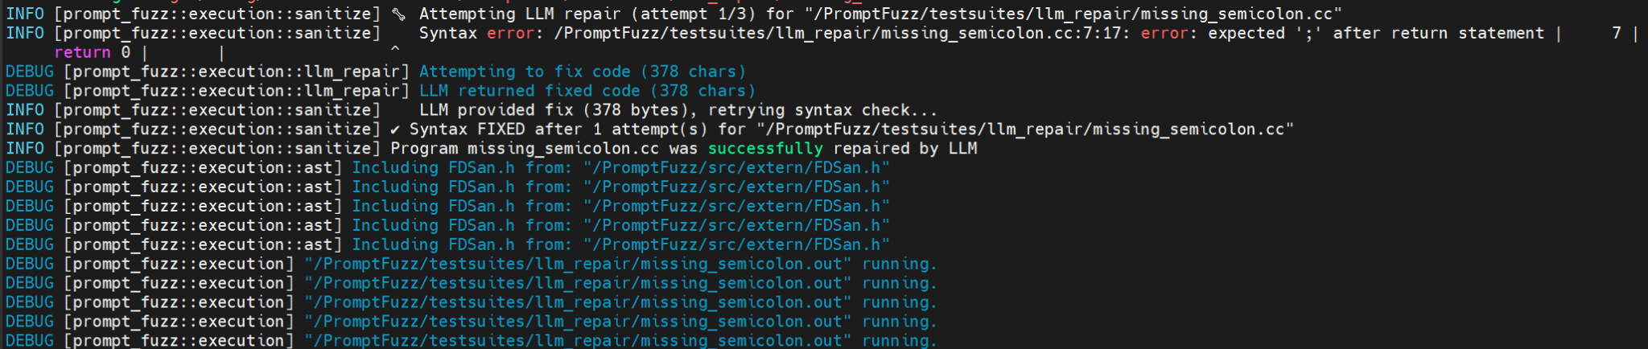
Test Example: 1 Try Fix

Slide 20
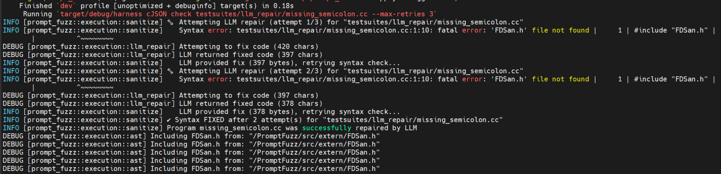
Test Example: Multiple Attempts to Fix
NOTE: Intentionally ran so FDSan.h would not be found, otherwise will run full sanitization.

Slide 21
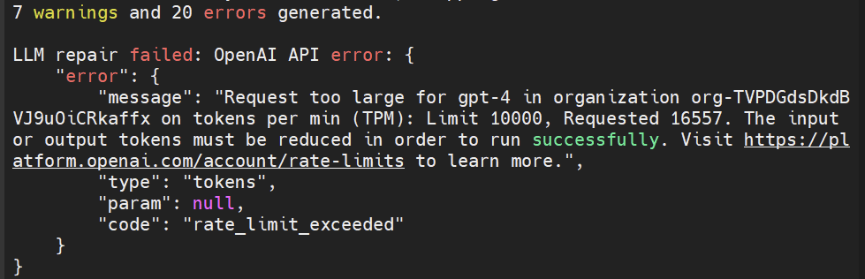
Why No Tests on a Full Library?
Often limited by Open AI API, requested number of tokens per minute too high.
Very slow to test full library and expensive for API tokens.
Challenge with vLLM - Small GPU and need an OpenAI API compatible model

Slide 22
Discussion Points
Prompt was effective at resolving syntax errors
Corrected programs returned to the seed bank
Potentially more resource efficient to repair instead of regenerate
Numerous spelling and grammatical errors in code and comments

Slide 23
Limitations
Long testing periods results in limited testing
Local LLMs slow and have small number of parameters (need more VRAM)
Paid APIs faster and more capable, but costs money [$$$]
Sanitization process takes very long
Limited contexts required = slower results
Only performed testing on the Libpcap and cJSON libraries
Can take a long time to find a syntax error with reasonable temperature
Longer testing periods prevents more thorough testing

Slide 24
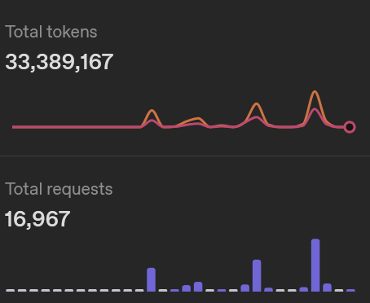
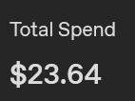
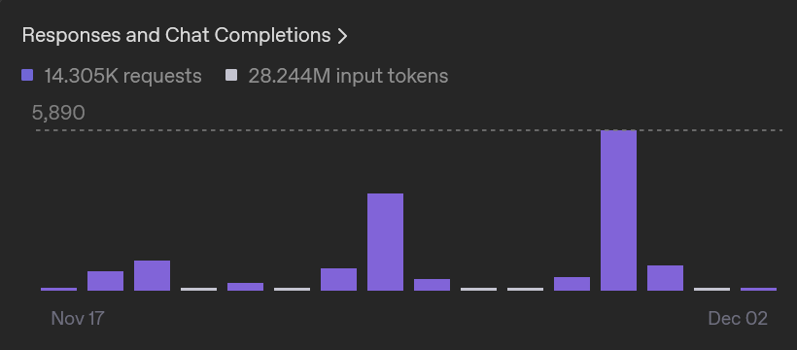
OpenAI API Usage and Expenditures

Slide 25
Future Work
Perform our initial methodology
Generate baseline data using PromptFuzz
Run RePromptFuzz with the same constraints
Compare results (not with original paper, 3.5 model is deprecated)
Tweak LLM repair module
More or less retries
Attempt more rigorous prompt-engineering techniques (Chain of Thought, Least to Most prompting)
Test Local vs paid API LLMs (gpt-oss-20b model on RIT HPC)

Slide 26
References
Yunlong Lyu, Yuxuan Xie, Peng Chen, and Hao Chen. 2024. Prompt Fuzzing for Fuzz Driver Generation. In Proceedings of the 2024 on ACM SIGSAC Conference on Computer and Communications Security (CCS '24). Association for Computing Machinery, New York, NY, USA, 3793–3807. https://doi.org/10.1145/3658644.3670396
Jiang, Y., Liang, J., Ma, F., Chen, Y., Zhou, C., Shen, Y., ... & Zhang, Q. (2024, July). When fuzzing meets llms: Challenges and opportunities. In Companion Proceedings of the 32nd ACM International Conference on the Foundations of Software Engineering (pp. 492-496).

Slide 27
References (con)
Amiet, N. (2023, December 7). Introducing fuzzomatic: Using AI to automatically fuzz rust projects from scratch. RSS. https://kudelskisecurity.com/research/introducing-fuzzomatic-using-ai-to-automatically-fuzz-rust-projects-from-scratch
Liu, D., M, J., & O, C. (2023). Fuzz target generation using llms. OSS-Fuzz. https://google.github.io/oss-fuzz/research/llms/target_generation/
Liu, D., M, J., & O, C. (2024). Leveling Up Fuzzing: Finding more vulnerabilities with AI. https://security.googleblog.com/2024/11/leveling-up-fuzzing-finding-more.html

Slide 28
Questions?

